Slide 1

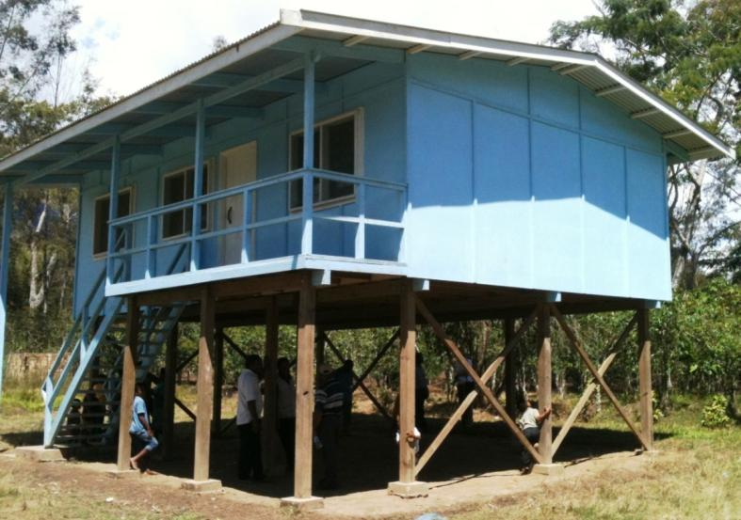
Introduction
This training package describes how poor design and construction practices contribute to the catastrophic collapse of South-east Asia and South Pacific village buildings, under the action of cyclones, earthquakes and tsunamis.

Slide 2
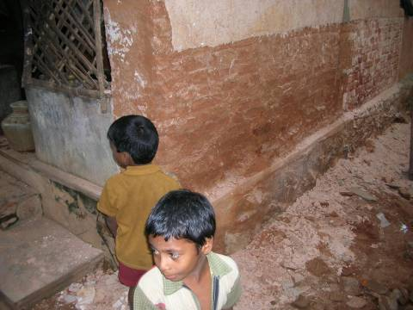
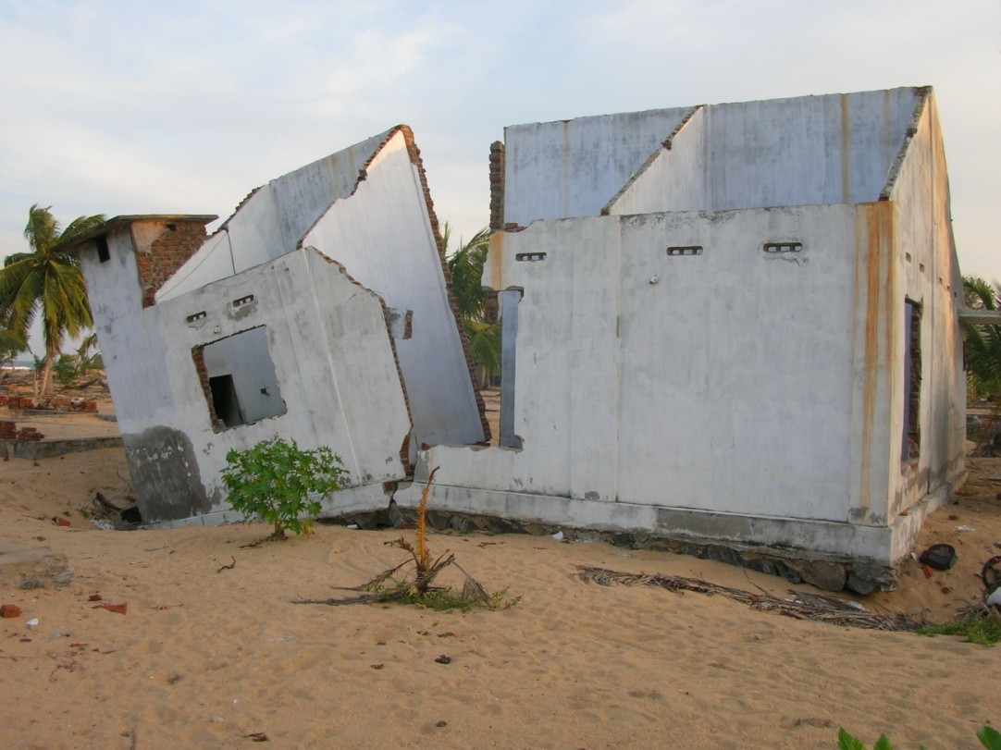
Construction Problems Under Cyclone, Earthquake & Tsunami
Let us pause for a moment,
and remember those killed in natural disasters
(just ordinary people like you and me)
in the wrong place at the wrong time.
The following pages are just a few examples of the devastating power of cyclonic winds, earthquakes and tsunamis in our region.

Slide 3
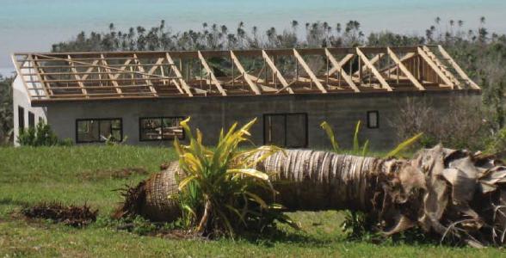
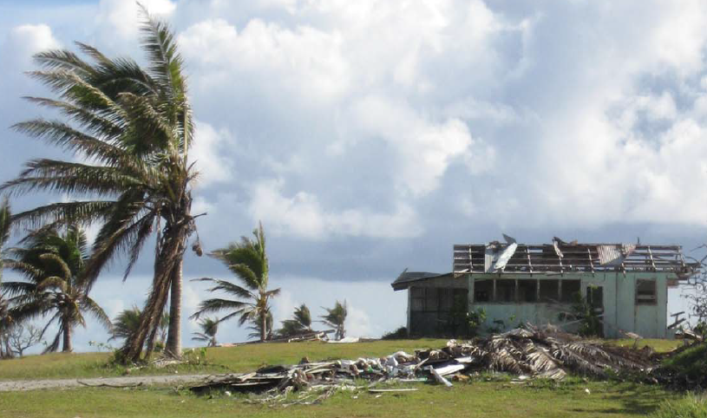
Cyclone Damage
Cook Islands, February 2010
Photos: Cyclone Damage on Aitutaki in the Cook Islands
Courtesy of D Kaunitz (Emergency Architects Australia)

Slide 4
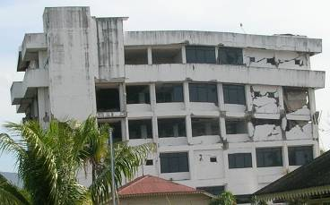
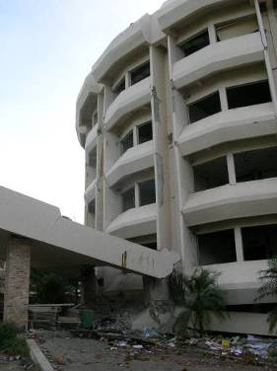
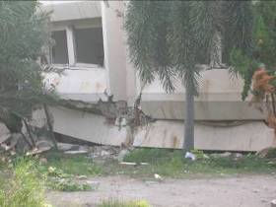
Earthquake Damage
Aceh Indonesia, December, 2004

Slide 5
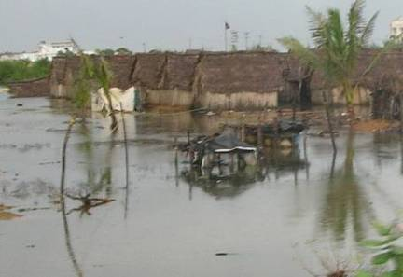
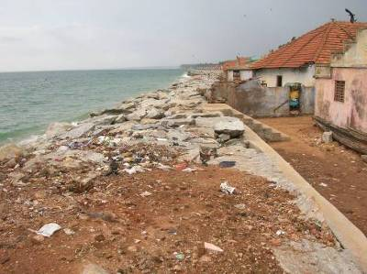
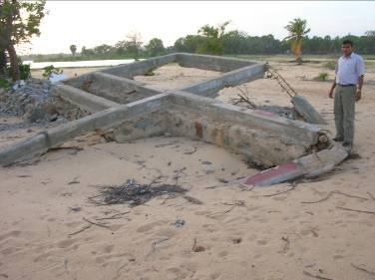
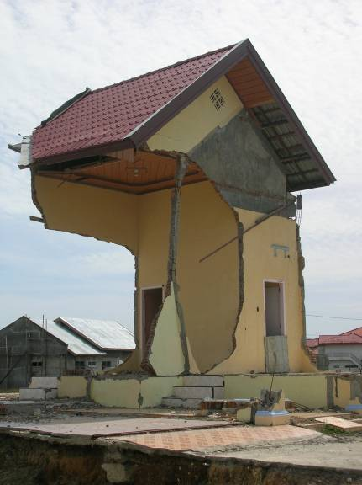
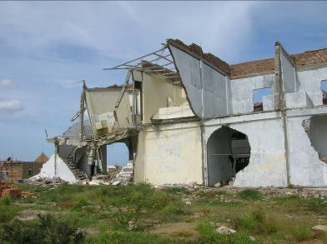

Tsunami Damage
Indonesia, Thailand, India, Sri Lanka – December 2004

Slide 6
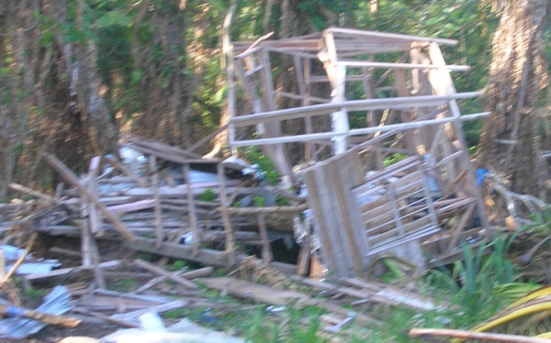
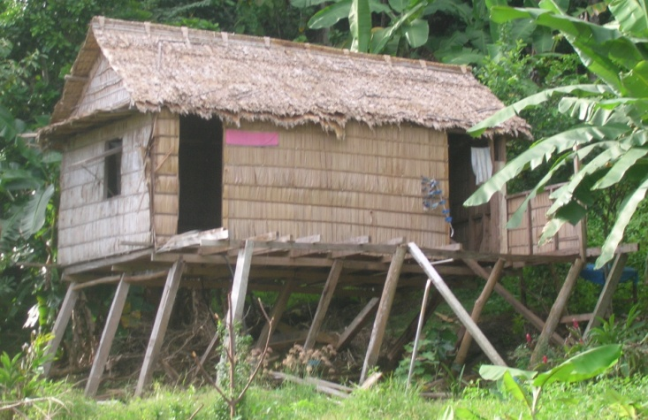
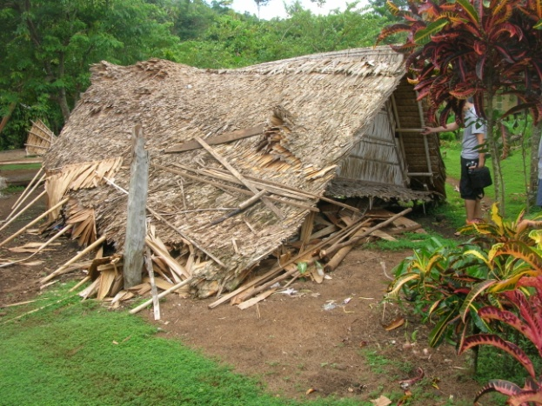
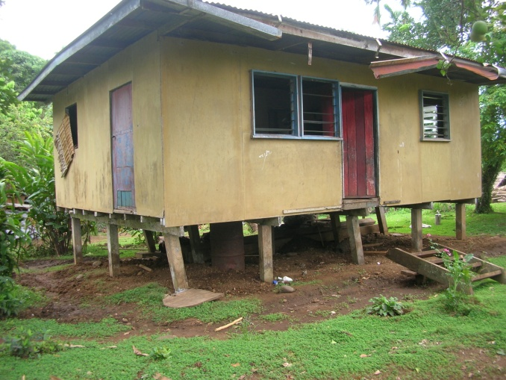
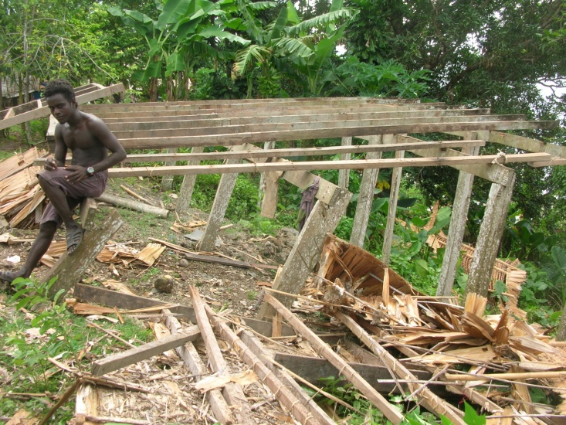
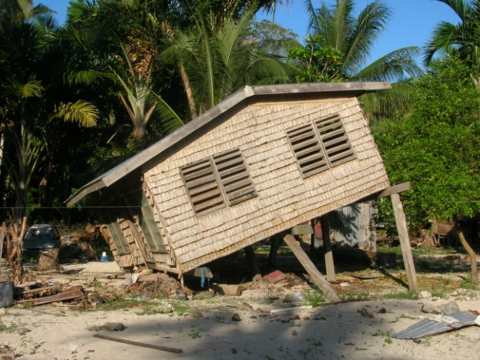
Earthquake and Tsunami Damage
Solomon Islands, April 2007

Slide 7
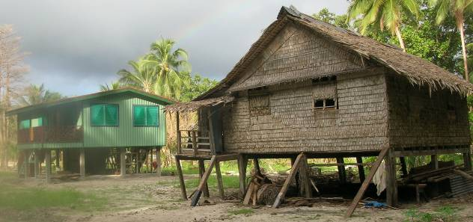
Some buildings are less prone to damage than others
Although subjected to the same cyclone, earthquake or tsunami, some houses remain virtually unscathed while others are destroyed or rendered unusable.
The following two houses, side by side, were both subjected to the 2007 Solomon Islands earthquake and tsunami. The more substantial green “timber and concrete house” includes adequate horizontal load resistance (in the form of a strong lower storey room), while the adjacent brown “leaf house” (without any bracing) is now unserviceable and requires temporary props to prevent collapse.
The common feature is that all surviving houses are well-built and braced (in some cases by braced lower storey walls, in other cases by diagonal bracing).

Slide 8
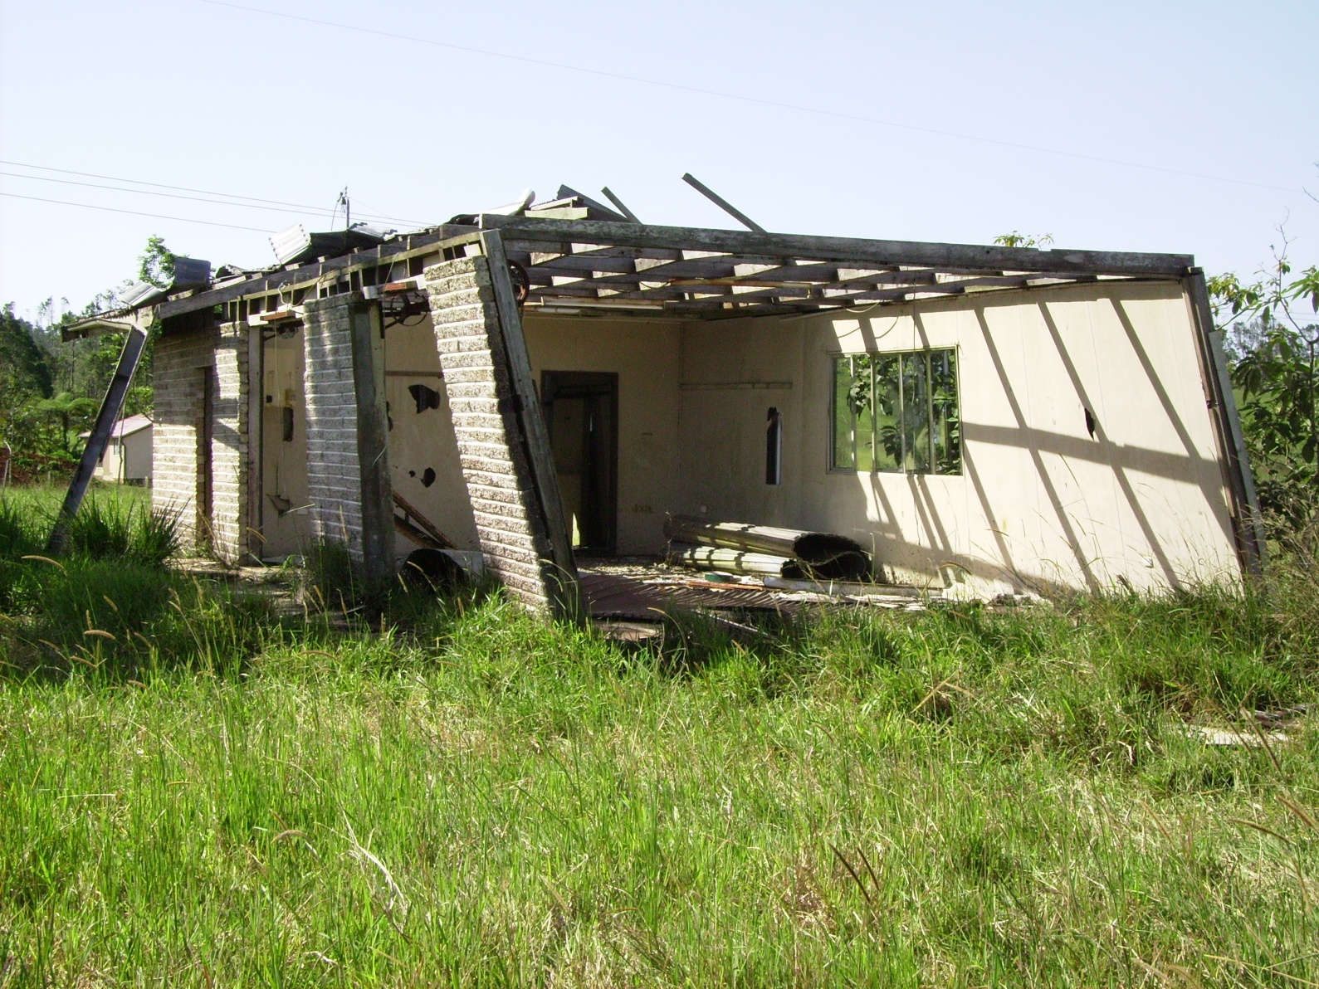
Poor design and construction contributes to failures
The following pages show various examples of both good and bad design or construction.
Lack of bracing

Slide 9
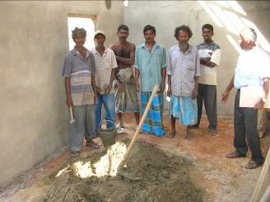
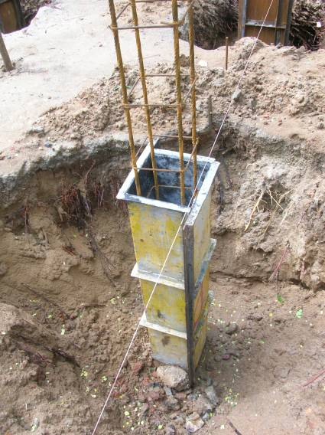
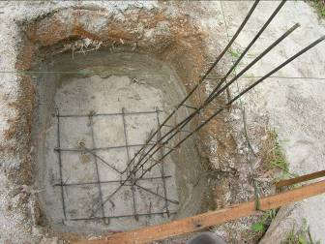
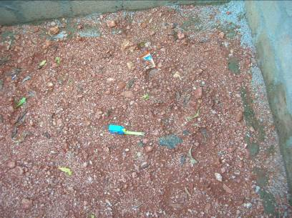
Compaction under Piers, Footings, Ring Beams and Slab-on-Ground
The foundations under concrete piers, footings, ring beams and slab-on-ground must be properly compacted. Weak soils should be excavated and replaced.
Unreinforced concrete
slab-on-ground
Sri Lanka (Trincomalee)
Pad Footings and Column Reinforcement
India (Villupurum)
Pad Footings and Column Reinforcement Thailand

Slide 10
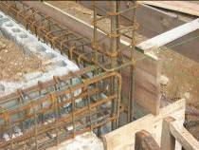
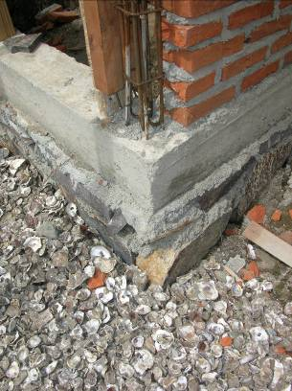
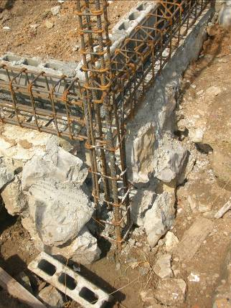
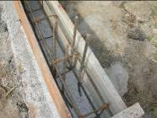
Reinforcement in Footings & Ring Beam
There must be sufficient reinforcement in ring beams, columns and footings
Aceh (Tibang)
Too much reinforcement in ring beams, columns and footings wastes money and makes it difficult to compact concrete
Aceh (Lam Kruet)

Slide 11
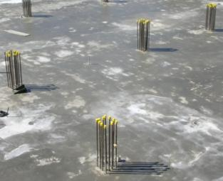
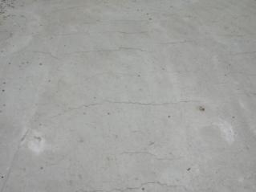
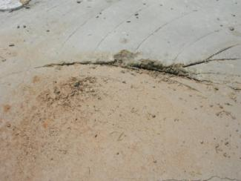

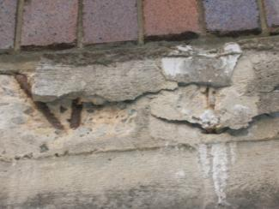
Too Much Water in Concrete
Strength – The strength of concrete, and its ability to support loads, can be severely reduced by too much water in the mix.
Cracking – As water evaporates from concrete during hardening, there is a tendency for “early-age cracking” and “drying shrinkage cracking”. The width and extent of cracks will increase as the amount of water is increased.
Delamination – If concrete is too wet when finished, it could dry and shrink at the surface, while remaining moist underneath, thus causing delamination.
Abrasion / Surface Dusting - Excessive moisture in concrete can lead to reduced abrasion resistance of the surface, ‘dusting’ and exposure of the coarse aggregate.
Durability – Concrete with excess water will be more prone to penetration by water and salts, and may exhibit reinforcement corrosion and surface spalling (concrete cancer).
Reference: Beware of excess water, Cement Concrete & Aggregates Australia, March 2006:

Slide 12
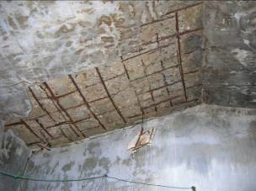
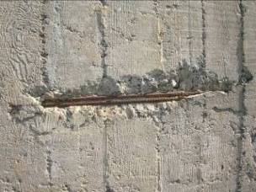
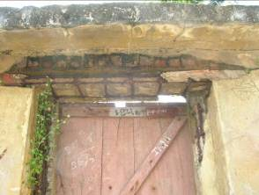
Reinforcement Cover in Concrete
Steel reinforcement must be surrounded with sufficient thickness of well-compacted concrete, to prevent corrosion of the steel and spalling of the concrete, commonly known as “concrete cancer”.
Suspended concrete roof corrosion (India)
Concrete wall corrosion (Australia)
Concrete lintel reinforcement corrosion (India)

Slide 13
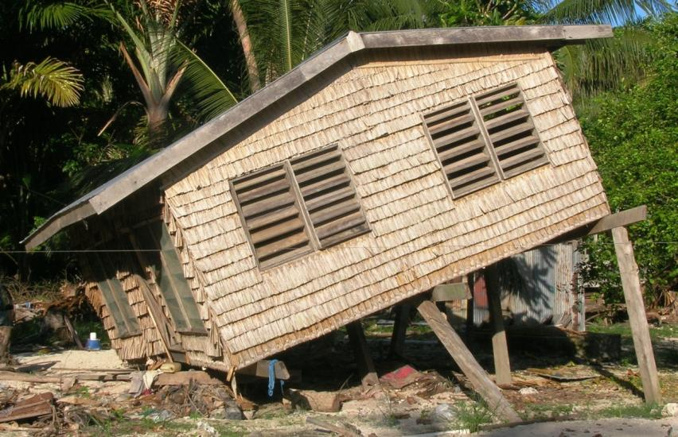
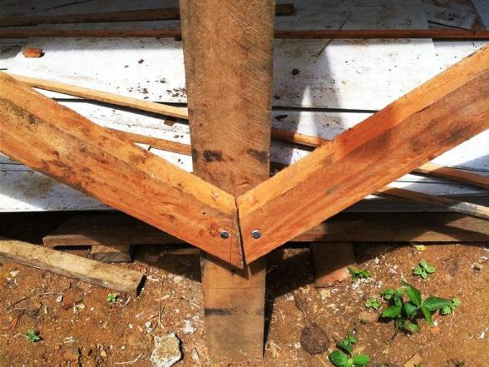
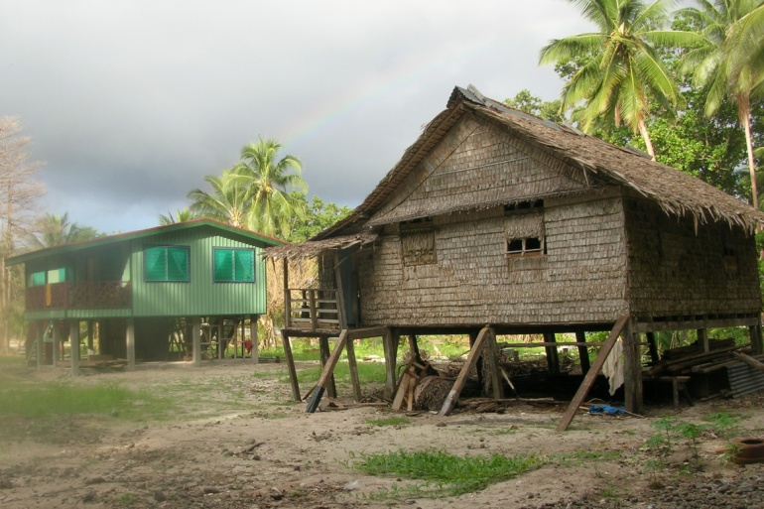
Sub-floor Bracing
Buildings must include adequate sub-floor bracing, that is adequately fixed into the structure.
Inadequate Bracing
(Solomon Islands)
Bolts too close to the end of timber brace
Papua New Guinea (Mt Hagen)

Slide 14
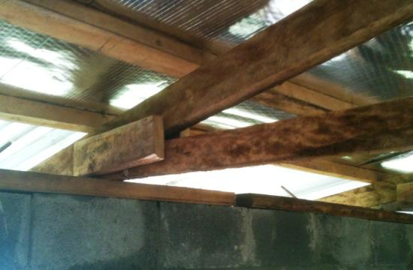
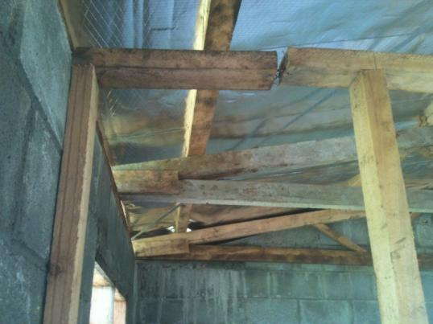
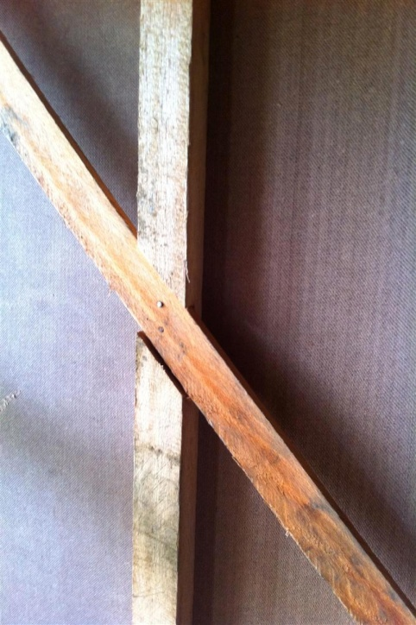
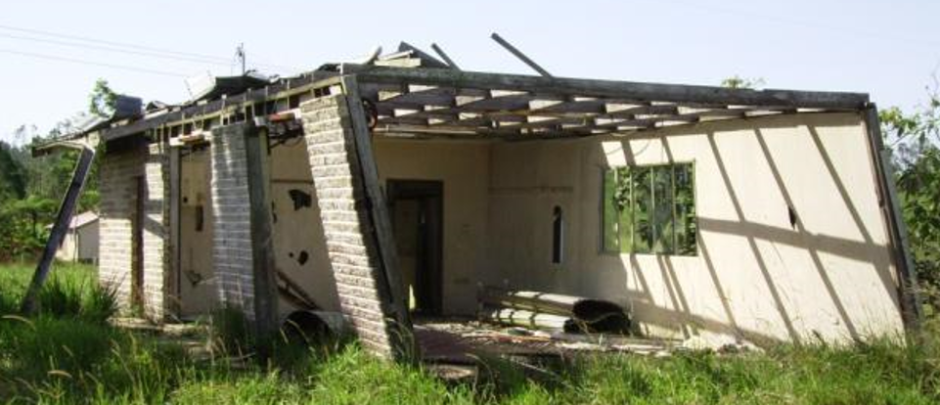
Wall Framing & Bracing
Buildings must also include adequate wall bracing.
Improvised Connectors – PNG
Inappropriate Joint in Top Plate – PNG
Wall Bracing –
PNG (Mt Hagen)
Inadequate Wall Bracing – Australia

Slide 15
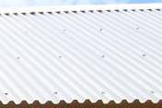
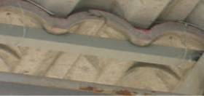
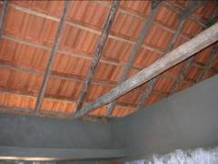
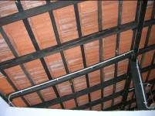
Anchorage of Roof Tiles or Roof Sheeting
The roof framing and cladding (including tiled or steel sheet roofing) must be adequately tied down to the structural frame.
Tiles tied down – Thailand Roof sheeting tied down – Indonesia
Tiles not tied down – India Tiles not tied down – Sri Lanka

Slide 16
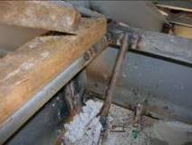
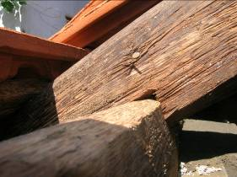
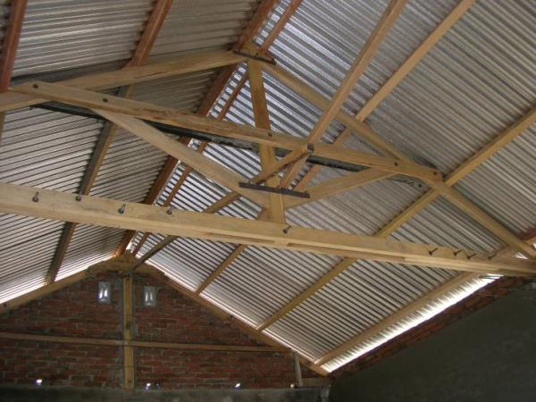


Anchorage of Roof Framing
Roof anchorages must be designed and constructed to resist wind uplift.
Welded Reinforcement - Thailand
Skew Nail - India
Bent reinforcement – Aceh
Framed Roof - Aceh

Slide 17





Fixing Masonry Walls Into the Structure
Masonry walls must be properly fixed into the structure.
Bonded Masonry - Sri Lanka (Trincomalee & Batticoloa)
Brick to Concrete Columns
Indonesia (Aceh)
No ties between columns and masonry – Sri Lanka (Galle)

Slide 18



Quality of Bricks, Blocks & Mortar
Bricks, blocks and mortar must be of the specified quality to ensure that they remain durable.
Concrete Blocks & Mortar
Sri Lanka (Batticoloa)
Clay Bricks & Mortar
India (Villupuram)

Slide 19
Disclaimer & Copyright
Disclaimer
This training package covers broad engineering principles and building practices, with particular emphasis on affordable housing and associated village infrastructure in the Asia-Pacific region. These broad principles and practices must be translated into specific requirements for particular projects by professional architects, engineers or builders with the requisite qualifications and experience. Associated sample specifications and drawings are available in electronic format, with the express intention that architects, engineers and builders will edit them to suit the particular requirements of specific projects. The design, construction and costing of structures must be carried out by qualified and experienced architects, engineers and builders, who must make themselves aware of any changes to the applicable standards, building regulations and other relevant regulations. The authors, publishers and distributors of these documents, specifications and associated drawings do not accept any responsibility for incorrect, inappropriate or incomplete use of this information.
Copyright
© Quasar Management Services Pty Ltd
  All rights are reserved. Permission is given for individuals to use this material in the preparation of designs, specification and contracts for individual projects. Permission is also given for not-for-profit Nongovernmental Organizations to use this material in the preparation of Building Skills Training Programs and for the design, specification and construction of affordable housing and associated infrastructure in the Asia-Pacific region. Use of this material for any other commercial purposes prohibited without the written permission of the copyright owner.

