Slide 1
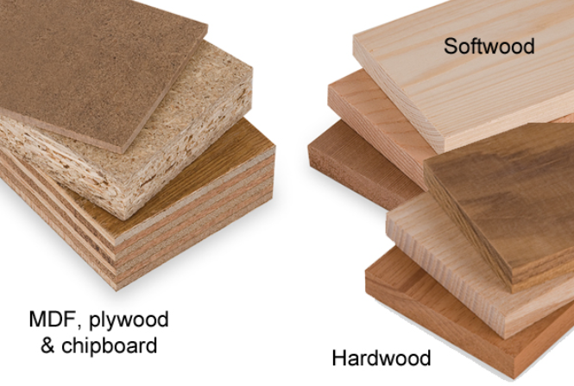
Timber Properties and Specification
This training package discusses the identification and specification of timber that is suitable for village buildings, common in South-East Asia and the South Pacific region. Editable specifications are available from Quasar Management Services Pty Limited.
Image Source: https://www.bing.com/images/search?q=png+hardwoods

Slide 2
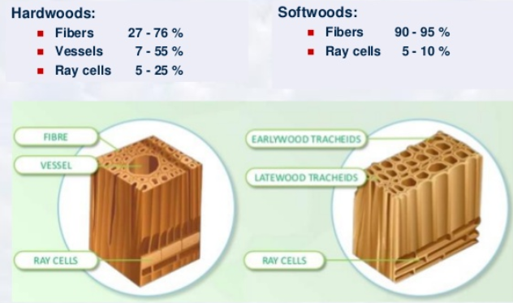
Hardwood or Softwood
Timber is classified as either hardwood or softwood.
Hardwoods grow relatively slowly, are relatively dense in the range 600 to 1,100 kg/m³, and relatively strong.
Softwoods grow relatively quickly, are less dense in the range 450 to 800 kg/m³, and have reduced strength.
Hardwood frames possesses strengths significantly in excess of softwood frames, due principally to superior behaviour at nailed, screwed and bolted joints. However, the availability of hardwood cannot always be predicted. Therefore, conservative designs are based on the use of softwood.
In the South Pacific, there is considerable variation in strengths of softwoods. Therefore, conservative designs are based on the use of stress grade F7.
If hardwood or softwood of stress grades higher than F7 are available, they should be used. This will provide a reserve of strength in the trusses and frames. If higher stress grades are not available, the careful use of F7 softwood, with close attention to the specified joint configurations, will result in structures of adequate strength.
Image Source: https://www.bing.com/images/search?q=png+hardwoods

Slide 3
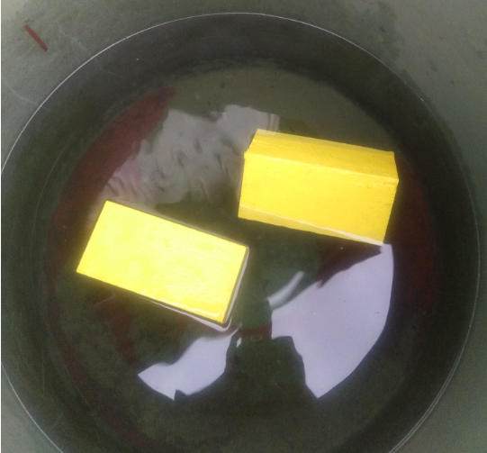
Is the Timber Hardwood or Softwood?
It is important for a builder the know the type of timber delivered to site, to confidently predict the properties. Experienced builders might recognise the type of timber by sight, but there is a very simple test that can be performed.
Hardwoods are relatively dense in the range 600 to 1,100 kg/m³, and will be mostly submerged when placed in fresh water.
Softwoods are less dense in the range 450 to 800 kg/m³, and will float approximately half submerged in fresh water.
Here is a simple test –
Cut a regular shaped piece of wood (as chunky as practical.) Preferable size is 100 x 100 x 150 mm long or larger.
Painting it would help seal it, although it is a bit time consuming and not necessary for such a simple test.
Place the piece of wood in a big bucket or tub of fresh water.
If it sinks, it is probably hardwood with a density greater than 1000 kg/m³. If it floats just above the surface, it is hardwood with a density of approximately 1000 kg/m³.
If it floats, protruding significantly from the surface, it is probably softwood. If it protrudes 50% above the water surface, it will have a density of 500 kg/m³. If it protrudes 25% above the water surface, it will have a density of 750 kg/m³…. and so on.

Slide 4
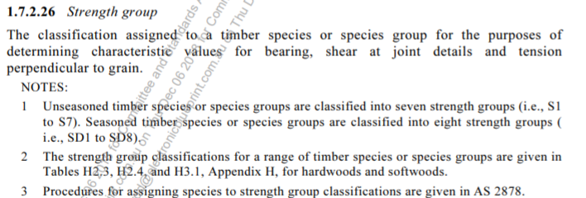
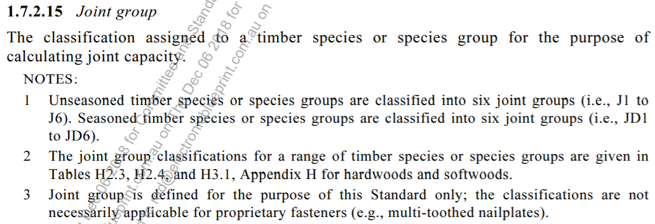
Timber Definitions
The following technical definitions (used in specifications and designs) are adapted summarised from Australian Standard AS 1720.1.
Hardwood is from trees classified botanically as Angiosperm. Hardwoods have vessels or pores.
Softwood is from trees classified botanically as Gymnosperm, such as conifers. Softwoods do not have pores.
Seasoned timber (such as “dry”, “air-dried” and “kiln-dried”) has a moisture content nominally between 10% and 15%.
Unseasoned timber (called “green” timber) has an average moisture content exceeding 25%.
Stress Grade is a broad classification of timber for a suite of strengths and stiffnesses for structural design –
F grades describe sawn timber and plywood, A grades are for sawn timber, MGP grades describe machine-graded pine, GL grades describe glue-laminated timber sections.
Strength Group is a classification of timber for calculating the bearing, shear and tensile strength of members.
S1 to S6 classifies unseasoned timber – S1 is the strongest. S6 is the weakest.
SD1 to SD6 classifies seasoned timber (such as commercially available seasoned softwoods). – SD1 is the strongest. SD6 is the weakest.
Joint Group is a classification of timber for calculating the strength of nailed, screwed and bolted connections.
J1 to J6 classifies unseasoned timber – J1 is the strongest. J6 is the weakest.
JD1 to JD6 classifies seasoned timber (such as commercially available seasoned softwoods). – JD1 is the strongest. JD6 is the weakest.

Slide 5
Timber Properties
The following extracts, from Australian Standard AS 1720.1, provide a sample of the Strength Group, Joint Group and Density of some common timbers, depending on whether they are seasoned or unseasoned.
The DANCER Building System is based on seasoned softwood (Stress Grade F7, Strength Group SD6, Joint Group JD4), which is shown highlighted.

Slide 6
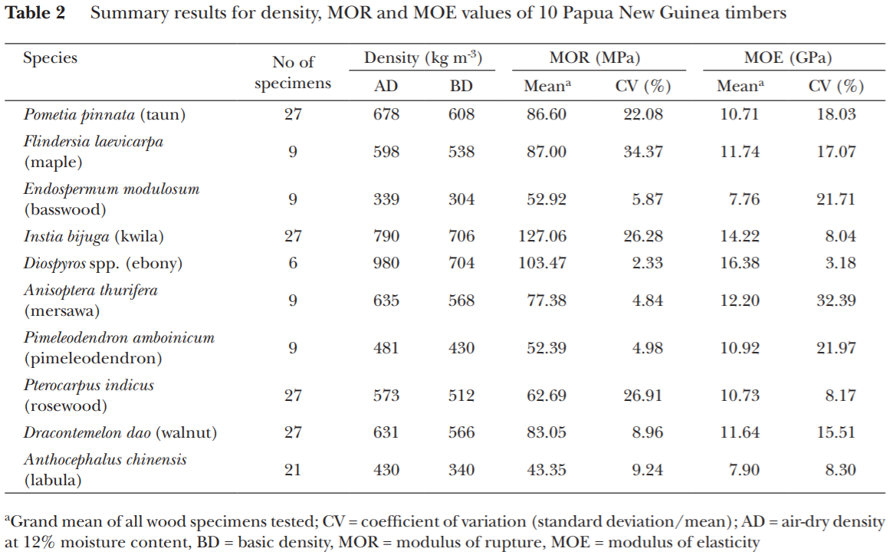
PNG Hardwood Properties
For the technically-minded, this table shows the measured properties of some PNG hardwoods.

Slide 7
Disclaimer & Copyright
Disclaimer
This training package covers broad engineering principles and building practices, with particular emphasis on affordable housing and associated village infrastructure in the Asia-Pacific region. These broad principles and practices must be translated into specific requirements for particular projects by professional architects, engineers or builders with the requisite qualifications and experience. Associated sample specifications and drawings are available in electronic format, with the express intention that architects, engineers and builders will edit them to suit the particular requirements of specific projects. The design, construction and costing of structures must be carried out by qualified and experienced architects, engineers and builders, who must make themselves aware of any changes to the applicable standards, building regulations and other relevant regulations. The authors, publishers and distributors of these documents, specifications and associated drawings do not accept any responsibility for incorrect, inappropriate or incomplete use of this information.
Copyright
© Quasar Management Services Pty Ltd
All rights are reserved. Permission is given for individuals to use this material in the preparation of designs, specification and contracts for individual projects. Permission is also given for not-for-profit Nongovernmental Organizations to use this material in the preparation of Building Skills Training Programs and for the design, specification and construction of affordable housing and associated infrastructure in the Asia-Pacific region. Use of this material for any other commercial purposes prohibited without the written permission of the copyright owner.

